Slide 1
Recurrence Relation

Slide 2
Recurrence Relation
A recurrence relation for the sequence, a0, a1, ...an, is an equation that relates an to certain of its predecessors a0, a1, ... , a_{n-1}.
Initial conditions for the sequence a0, a1, ... are explicitly given values for a finite number of the terms of the sequence.

Slide 3
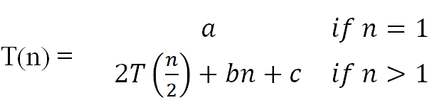
Recurrence Relation
A recurrence relation, T(n), is a recursive function of integer variable n.
Like all recursive functions, it has both recursive case and base case.
Example:
The portion of the definition that does not contain T is called the base case of the recurrence relation; the portion that contains T is called the recurrent or recursive case.
Recurrence relations are useful for expressing the running times (i.e., the number of basic operations executed) of recursive algorithms

Slide 4
Recurrence Relation
Example : Fibonacci sequence
Recursive case : f_{n} = f_{n-1} + f_{n-2} , n>=3
Base case : f₁ = 1, f₂ =1
Fibonacci sequence : 1,1,2,3,5,8,13,21,…….

Slide 5
Recurrence Relation
Forming Recurrence Relation
The base case is reached when n == 0. The method performs one comparison. Thus, the number of operations when n == 0, T(0), is some constant a.
When n > 0, the method performs two basic operations and then calls itself, using ONE recursive call, with a parameter n – 1.
Therefore the recurrence relation is:
T(0) = a n=0
T(n) = b + T(n-1) n>0
Void f (int n)
{
if(n>0)
{
count<<n;
f(n-1);
}
}

Slide 6
Recurrence Relation
Forming Recurrence Relation
The base case is reached when n == 1. The method performs one comparison and one return statement. Therefore, T(1), is constant c.
When n>1, the method performs TWO recursive calls, each with the parameter n/2, and some constant # of basic operations.
Hence, the recurrence relation is:
T(1) = c n=1
T(n) = b + 2T(n/2) n>1
int g(int n)
{
if (n == 1)
return 2;
else
return 3 * g(n / 2) + g( n / 2) + 5;
}

Slide 7
Recurrence Relation
Methods to solve recurrence relations
Mathematical induction (Guess and Verify)
Substitution method
Recursion Tree method
Master method

Slide 8
Recurrence Relation Mathematical induction (Guess and Verify)
A technique for solving a linear recurrence equation by making a guess and verifying the guess using mathematical induction
Example
t_{n} = t_{n-1} + 2
t₀ = 1
Guess
t₀ = 1
t₁ = t₁₋₁ + 2 = 3
t₂ = t₂₋₁ + 2 = 5
t₃ = t₃₋₁ + 2 = 7
odd number series
Solution : t_{n} = 2n +1

Slide 9
Recurrence Relation Mathematical induction (Guess and Verify)
Verify using mathematical induction
Basic hypothesis
n = 0
t₀ = 2 * 0 + 1 = 1 true for n = 1
Induction hypothesis
Assume the equation, t_{n} = 2n +1 holds true for n = k
t_{k} = 2k +1
t_{k} = t_{k-1} + 2
to prove for k+1:
t_{k+1} = 2(k+1) + 1 = 2k + 3
t_{k+1} = t_{(k+1)-1} + 2
= t_{k} + 2
= (2k + 1) + 2
= 2k + 3 hence the equation t_{n} = 2n +1 holds true for n = k + 1
t_{n} = 2n + 1

Slide 10
Recurrence Relation Substitution method
Substitution method
Iteration Method
Steps
Plug : Substitute repeatedly
Chug : Simplify the expression
Types
Forward Substitution : solution obtained by repeated substitution from base condition onwards
Backward Substitution : Substitution starts from the last term and proceeds to the initial term
Process:
Expand the recurrence
Express the expansion as a summation by plugging the recurrence back into itself until you see a pattern.
Evaluate the summation

Slide 11
Recurrence Relation Substitution method
T(0) = c
T(n) = b + T(n - 1)
= b + b + T(n - 2)
= b +b +b + T(n - 3) …
= kb + T(n - k)
When k = n,
T(n) = nb + T(n - n)
= bn + T(0)
= bn + c
factorial = O(n)
long factorial (int n)
{
if (n == 0)
return 1;
else
return n * factorial (n – 1);
}

Slide 12
Recurrence Relation Substitution method : Forward Substitution
Given
t_{n} = t_{n-1} + 3
t₀ = 4
Solution
t₀ = 4
t₁ = t₀ +3 = 4 + 3
t₂ = t₁ + 3 = [4 + 3] + 3 = 4 + (2*3)
t₃ = t₂ + 3 = [4 + 2*3] + 3 = 4 + (3*3)
.
.
.
t_{n} = 4 + 3n ➔ O(n)

Slide 13
Recurrence Relation Substitution method : Backward Substitution
Given
t_{n} = t_{n-1} + 3
t₀ = 4
Solution
t_{n} = t_{n-1} + 3 here t_{n-1} = t_{n-2} + 3
= [t_{n-2} + 3] + 3
= t_{n-2} + 2 * 3 here t_{n-2} = t_{n-3} + 3
= [t_{n-3} + 3] + 2 * 3
= t_{n-3} + 3 * 3 here t_{n-3} = t_{n-4} + 3
= [t_{n-4} + 3] + 3 * 3
= t_{n-4} + 4 * 3
.
.
t_{i} = t_{n-i} + i * 3
when i = n-1 the resulting equation would be as follows
t_{i} = t_{n-i} + i * 3
= t_{n-(n-1)} + (n-1) * 3
= t₁ + 3(n-1) here t₁ = 4
= 4 + 3(n-1)
= 3n + 1
t_{n} = 3n + 1 ➔ O(n)

Slide 14
Recurrence Relation
Recursion-tree method
A recursion tree models the costs (time) of a recursive execution of an algorithm.
The recursion tree method is good for generating guesses for the substitution method.
The recursion-tree method can be unreliable
The recursion-tree method promotes intuition, however.
In this case, only the largest term in the geometric series matters; all of the other terms are swallowed up by the Θ(·) notation.

Slide 15
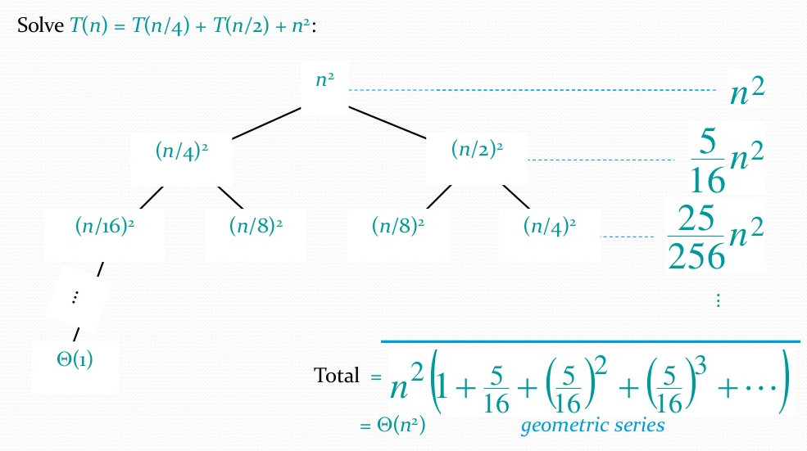
Recurrence Relation Recursion-tree method

Slide 16
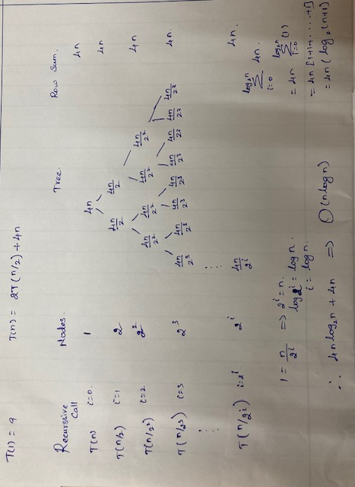
Recurrence Relation Recursion-tree method

Slide 17
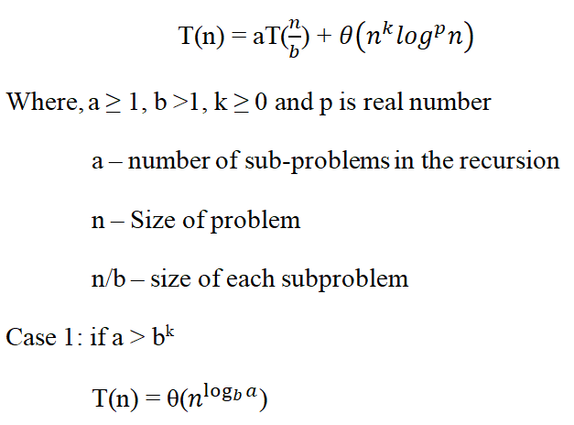
Recurrence Relation
Master Theorem
Used for solving divide-and-conquer recurrence relation

Slide 18
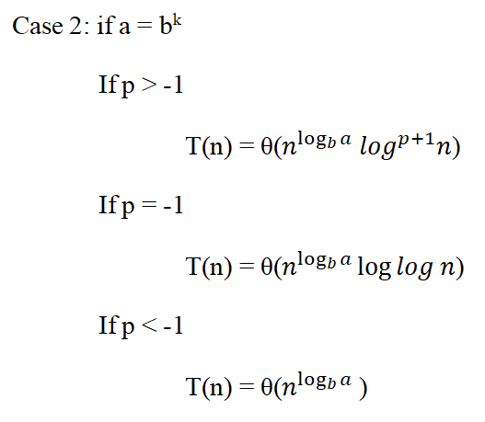
Recurrence Relation

Slide 19
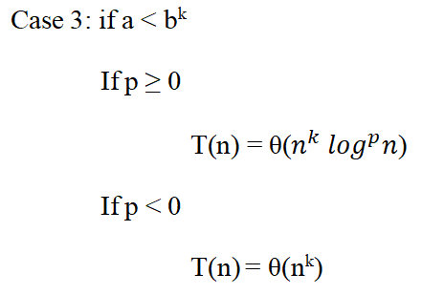
Recurrence Relation

Slide 20
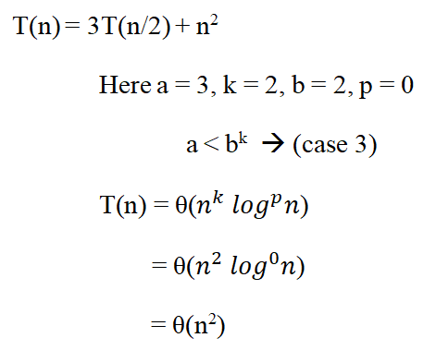
Recurrence Relation Master Theorem
Example

